Slide 1
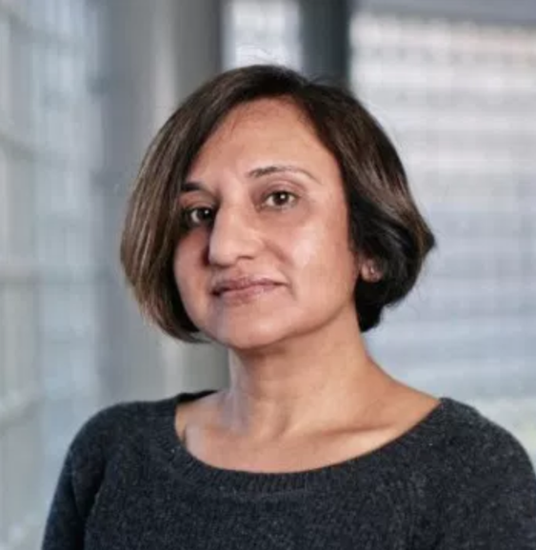
Accessibility Trends
508
Presented by: Preety Kumar, CEO, Deque Systems, Inc.
#CSUNATC18
AUDIT
ARIA
ADA
WCAG

Slide 2
A11Y Trends 2017
Global Trends
US Trends
Market Trends – Consumer Web
Technology Trends
Digital Transformation
Agile/DevOps
Machine Learning
Some macro thoughts

Slide 3
Global Trends - Europe
 | Harmonized with WCAG 2.0 - across Europe and the UK, WCAG 2.0 Level A & AA are the expected conformance levels
 | Limited to Public Sector - Directive on accessibility of websites and mobile apps passed in 2016. Accessibility as award criteria in tenders (procurement)
 | Promises and pitfalls of universal design – “carrot” approach is prevalent. UD seen as a human right issue but beware UD that misses
 | Low Employment of PwDs – disability employment gap is large due to general economic challenges
Notes:
Web use in Norway is among the highest in the world. 90% of citizens actively using the web.
Europe (PwDs pop. 120 million by 2020) Source: European commission

Slide 4
Global Trends - Canada
Canada survey – where should a11y efforts be focused

Slide 5
Global Trends – Canada (contd.)
Canada survey – how to improve enforcement

Slide 6
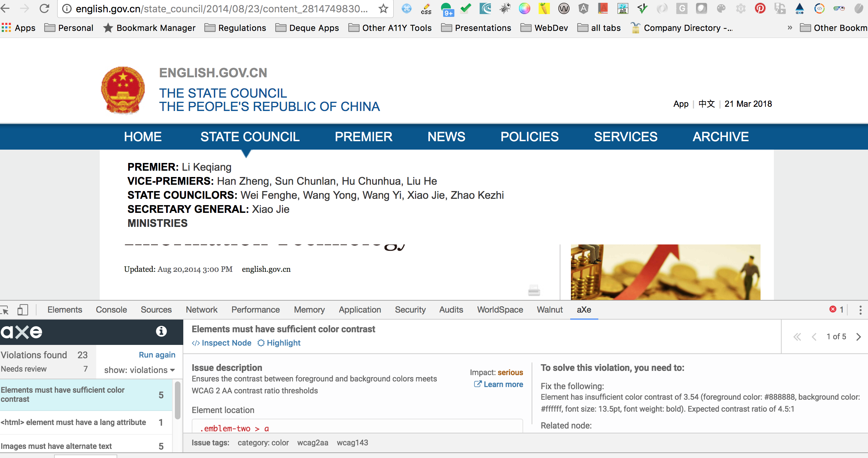
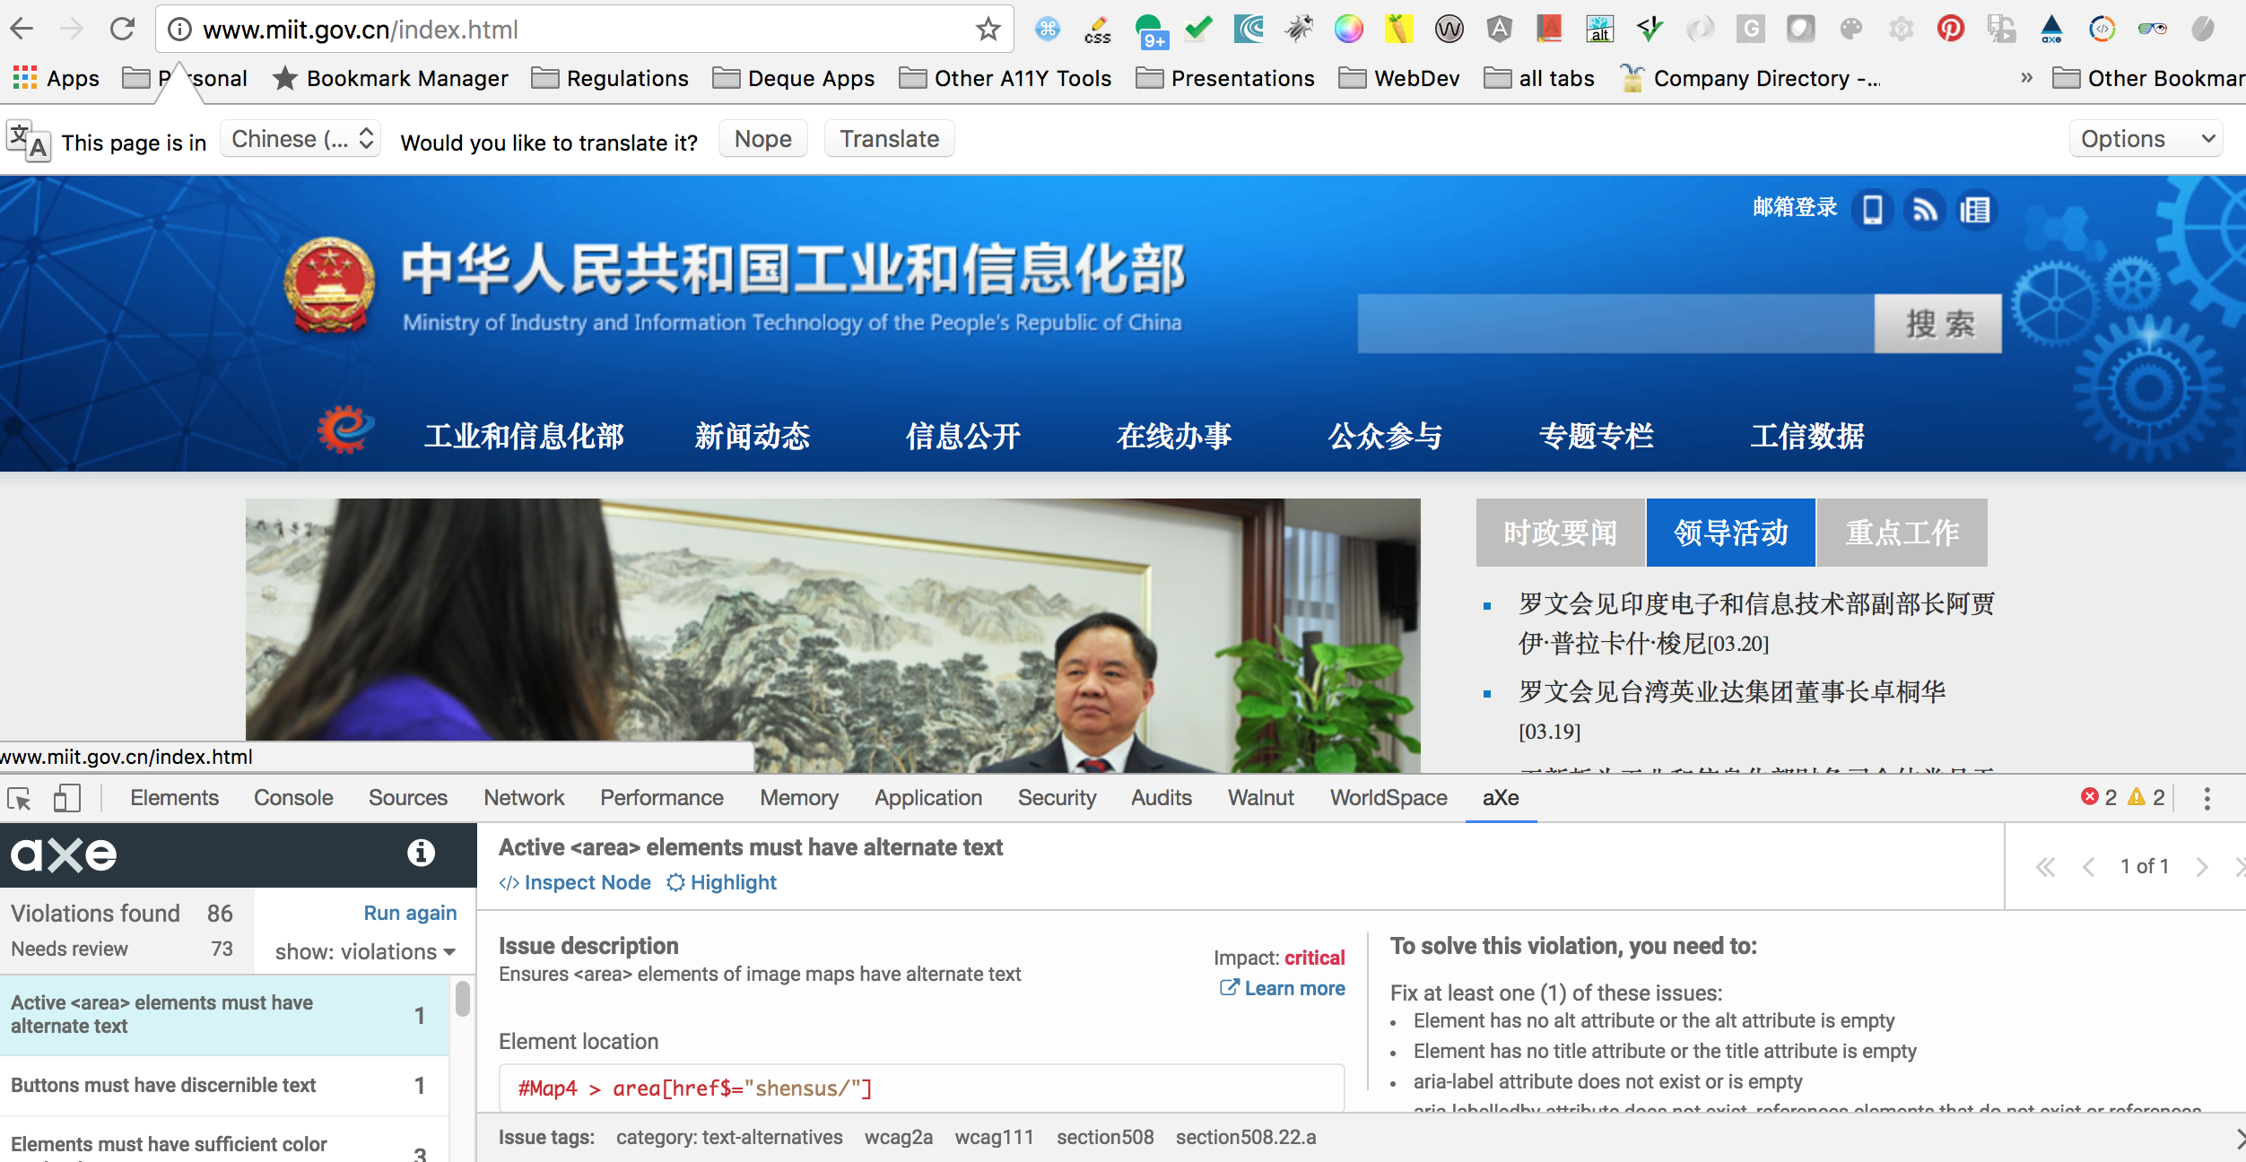
Global Trends - China
“Voluntary” Web Accessibility Standard published by Ministry of Industry and Information Technology = Truly “voluntary”
Notes:
(PwDs pop. 83 million)
Source UN
Canfei – handicapped and useless; sha zi – idiot
Moving to Can Zhang which means incomplete and obstructed

Slide 7
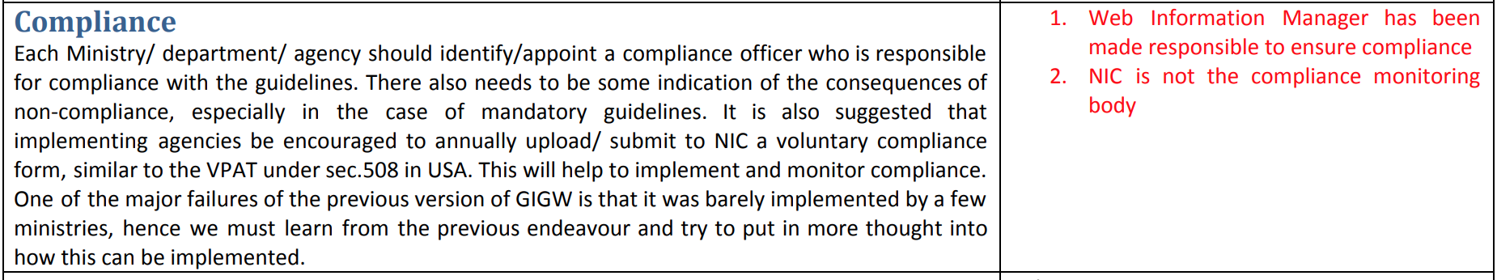
Global Trends - India
Rights of Persons with Disabilities Act (Dec 28, 2016)
Notes:
India (Population of PwDs: 22 million – source Census, India – I do not believe that). World Bank report states 40-80 million PwDs

Slide 8
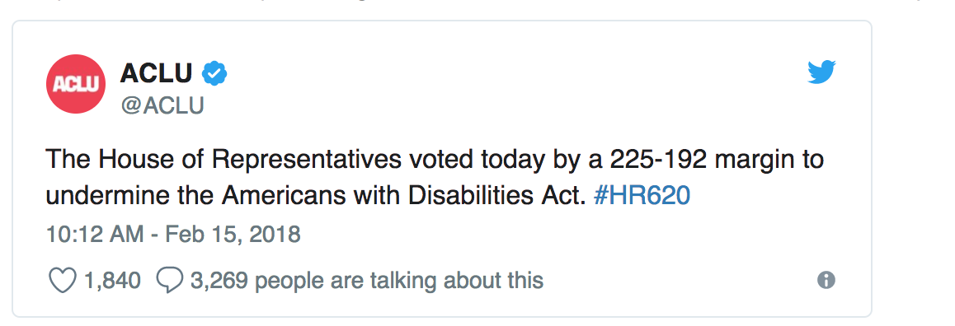
US Trends
Supplementary Information: The Department of Justice is formally announcing the withdrawal of four previously announced Advance Notices of Proposed Rulemaking (ANPRMs) pertaining to title II and title III of the Americans with Disabilities (ADA): (I) Nondiscrimination on the Basics of Disability; Accessibility of Web Information and Services of Public Accommodations (RIN 1190-AA61); (2) Nondiscrimination on the Basics of Disability in State and Local Government Services; Next Generation 9-1-1 (RIN 1190-AA62); (3) Nondiscrimination on the Basis of Disability by State and Governments and Place of Public Accommodation; Equipment and Furniture (RIN 1190-AA64); and (4) Nondiscrimination on the Basics of Disability: Accessibility of Web Information and Services of State and Local Government (RIN 1190-AA65).

Slide 9
Market Trends – Consumer Websites

Slide 10
A11Y of FinServ Y over Y
Site Home Page | 2016 | 2017 | 2018
JPMorgan Chase | 2 | 16 | 1
Bank of America | 3 | 5 | 10
Wells Fargo | 4 | 8 | 1
Morgan Stanley | 30 | 2 | 41
Capital One | 0 | 10 | 8
American Express | 5 | 30 | 16
Fidelity | 5 | 5 | 43
Northwestern Mutual | 9 | 8 | 14
Mastercard | 12 | 7 | 21

Slide 11
A11Y of Airlines Y over Y
Site Home Page | 2016 | 2017 | 2018
United | 1 | 7 | 6
Delta | 3 | 7 | 8
American | 3 | 1 | 6
Southwest | 2 | 0 | 4
Air Canada | 3 | 11 | 68
Alaska Airlines | 4 | 6 | 6
Westjet | 44 | 22 | 24
Jetblue | 56 | 6 | 4
AeroMexico | 112 | 48 | 10

Slide 12
A11Y of Healthcare Y over Y
Site Home Page | 2016 | 2017 | 2018
Healthcare.gov | 2 | 6 | 0
Walgreens | 6 | 38 | 16
Mayo Clinic | 16 | 14 | 20
Weight Watchers | 32 | 32 | 16
Drugs.com | 115 | 66 | 77
WebMD.com | 129 | 118 | 87

Slide 13
A11Y of Retail Y over Y
Site Home Page | 2016 | 2017 | 2018
Target | 3 | 1 | 5
Best Buy | 24 | 5 | 6
IKEA (US) | 26 | 42 | 6
Ebay | 27 | 5 | 1
Amazon | 30 | 27 | 28
Netflix | 43 | 9 | 8
Home Depot | 49 | 10 | 20

Slide 14
A11Y of Media/Entertainment Y over Y
Site Home Page | 2017 | 2018
Gawker | 69 | 73
MTV | 75 | 46
RottenTomatoes | 75 | 62
CNN | 81 | 67
USA Today | 112 | 186
Tumblr | 131 | 16
Disney | 134 | 117
IMDB | 285 | 67

Slide 15
A11Y of Top 20 Banks
Rank | Bank Home Page | Total assets | 2018 aXe Issues
1 | JPMorgan Chase | $2.53 trillion | 1
2 | Bank of America | $2.28 trillion | 10
3 | Wells Fargo | $1.95 trillion | 1
4 | Citigroup | $1.84 trillion | 1
5 | Goldman Sachs | $917 billion | 115
6 | Morgan Stanley | $851 billion | 41
7 | U.S. Bancorp | $462 billion | 13
8 | TD Bank (US) | $381 billion | 11
9 | PNC | $380 billion | 18
10 | Bank of New York Mellon | $371 billion | 8

Slide 16
A11Y of Top 20 Banks (contd.)
Rank | Bank name | Total assets | 2018 aXe Issues
11 | Capital One Financial Corp. | $365 billion | 8
12 | HSBC | $273 billion | 2
13 | Charles Schwab | $243 billion | 63
14 | State Street | $238 billion | 10
15 | BB&T | $221 billion | 0
16 | Suntrust | $205 billion | 83
17 | American Express | $181 billion | 16
18 | Ally Financial | $167 billion | 9
19 | Barclays | $157 billion | 42
20 | USAA | $155 billion | 9

Slide 17
Technology Trends – Digital Transformation
Digital at the speed of light
in 2013, HSBC employed more developers than Google and speeding up the flow
In 2011, Amazon was performing 7k deploys a day, in 2015, 130k deploys a day
Crawl, Walk, Run (piggy-back on digital transformation initiatives)
Define value (executive support, clear targets, funding)
Launch (high-caliber team, lighthouse projects, agile practices)
Scale (sequence for quick returns, build replicable capabilities, help with adoption)
Notes:
A bank is an IT shop with a banking license.

Slide 18
Technology Trends – Agile/DevOps
Culture of fear is being replaced with high-trust, collaborative culture
Everyone owns “quality”
Automation of testing throughout deployment pipelines
Optimal combination of Scripted & Exploratory testing
Reducing work in progress by division of labor
Prevent rework by not passing defects downstream
Feedback loops for better detection & recovery
Continual learning –daily practice☺

Slide 19
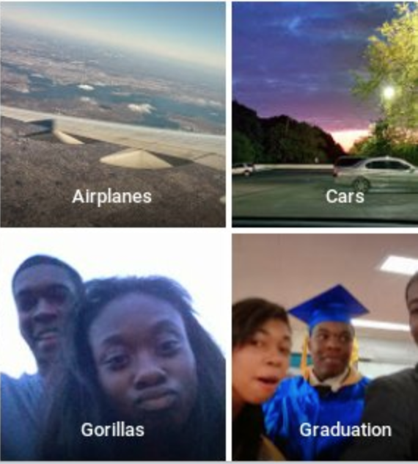

Technology Trends – Machine Learning/AI leveling the playing field
Auto alt for images
Auto captioning (YouTube)
Improving developer’s lives by increasing automation in accessibility testing
Good/non-biased datasets are important
Notes:
Not as good as the captioning in our accessible Karaoke

Slide 20
Some Macro Thoughts…
Don’t you forget about a11y
Future is ”pictures”
Future is “voice”
Augmented/Virtual Reality
Raising the bar
customer support, quality and demand for transparency increasing because of social media
user experience is key for ongoing relationships a11y = better user experience

Slide 21
Questions?

